Slide 1
Bone Suppression Related Paper Highlights
Reporter: Benny Chan Yifei Sun
Institute: Hangzhou Dianzi University

Slide 2
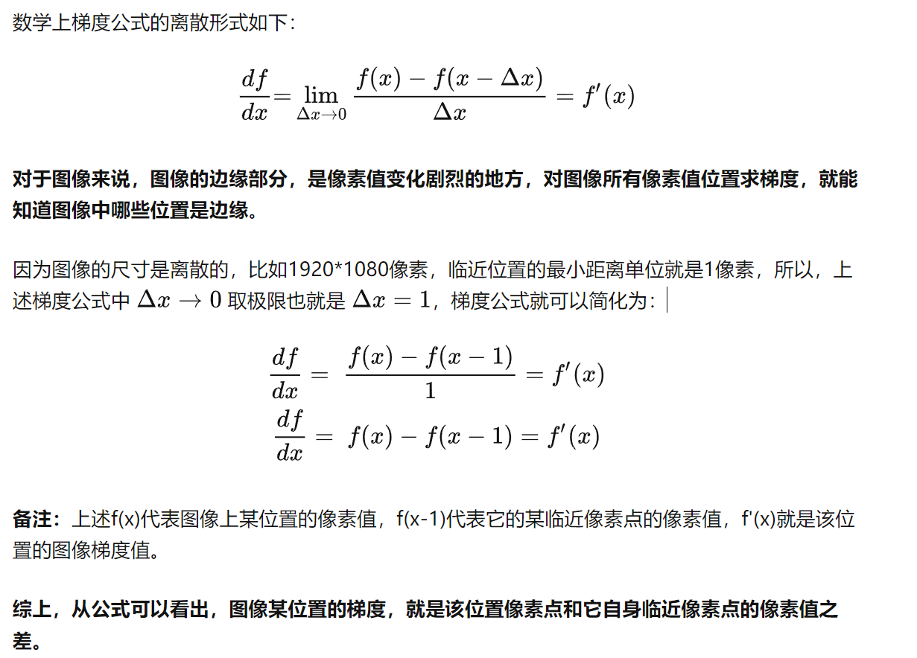
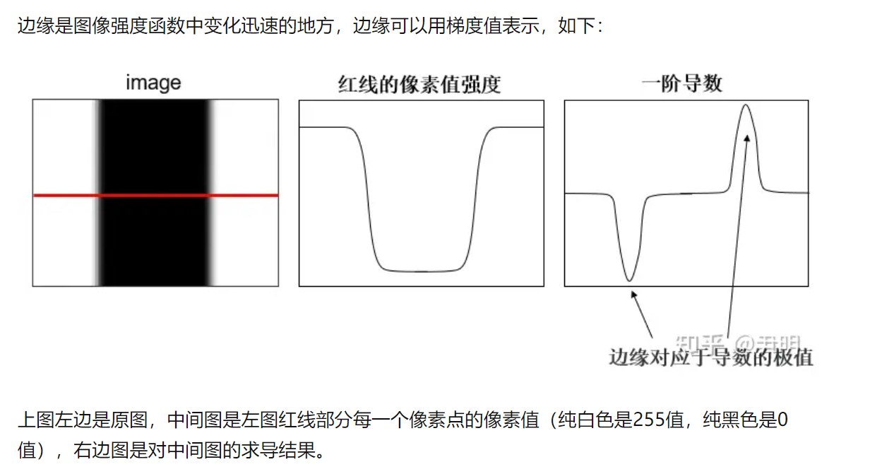
计算机视觉CS131：专题3-图像梯度、边缘检测（sobel、canny等）
https://zhuanlan.zhihu.com/p/618158237?utm_id=0

Slide 3
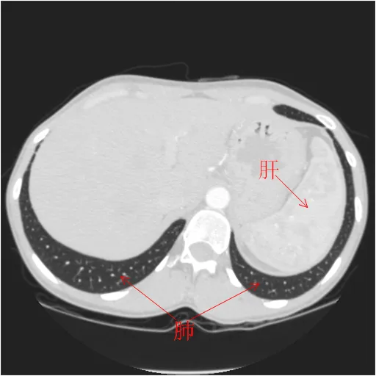
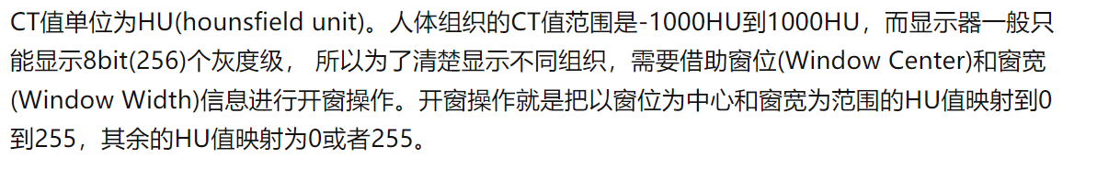
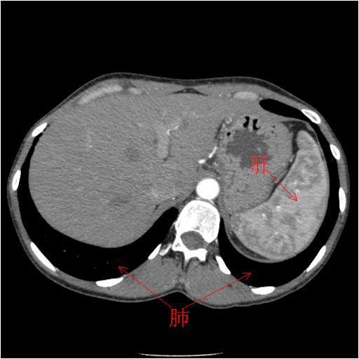
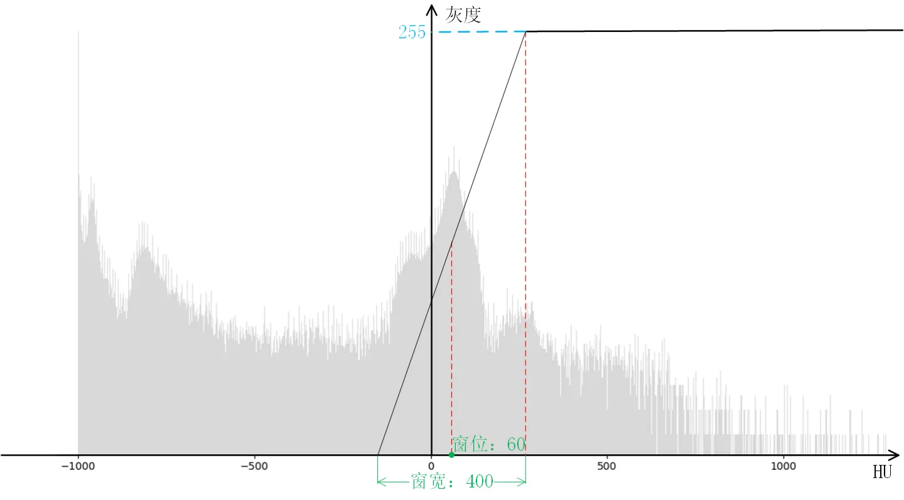
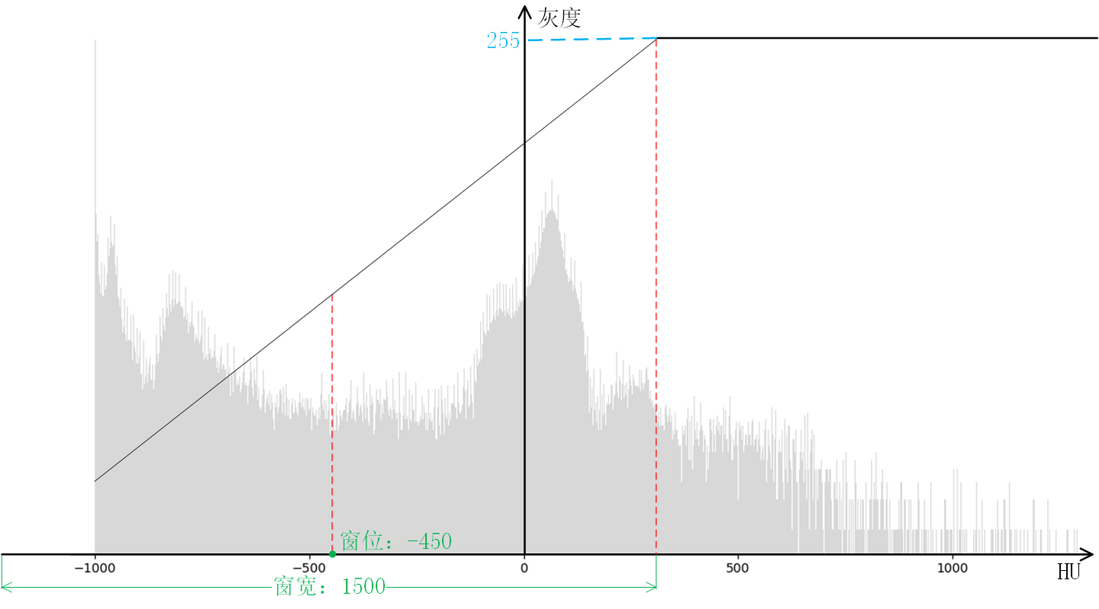
CT图像中的窗宽和窗位
https://zhuanlan.zhihu.com/p/474719876
通常我们称CT图像为DICOM(Digital Imaging and Communications in Medicine)图像，但是DICOM不是一个图像或者文件格式，它是包含了传输、存储、检索、打印、处理和显示医学图像信息方面的国际标准(ISO 12052)。
窗位:-450，窗宽:1500时CT图像的显示效果，此时可以清楚地看出肺部的细节信息，而腹部器官肝脏的纹理信息将不再清晰
窗位:60，窗宽:400时CT图像的显示效果。由图可以清晰地看出腹部器官肝脏(HU值在50到70之间)的纹理信息，而肺部的细节基本没有展现

Slide 4
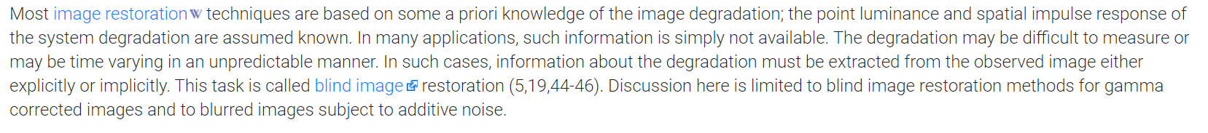
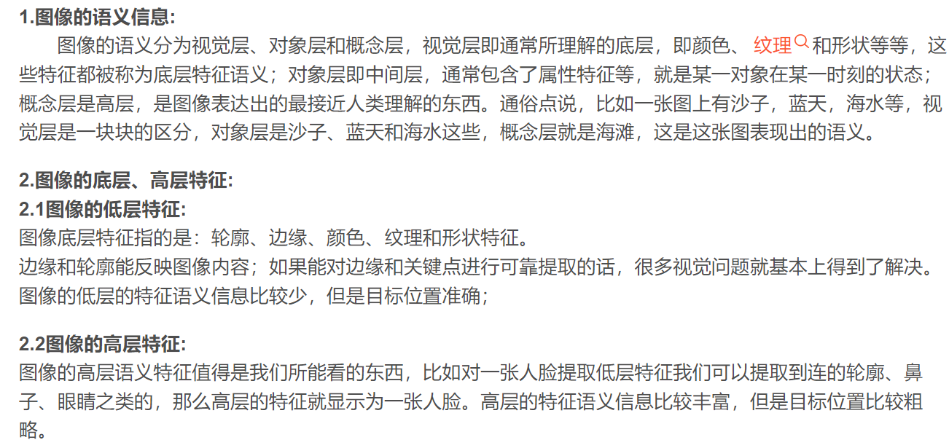
CRNet: Unsupervised Color Retention Network for Blind Motion Deblurring

Slide 5
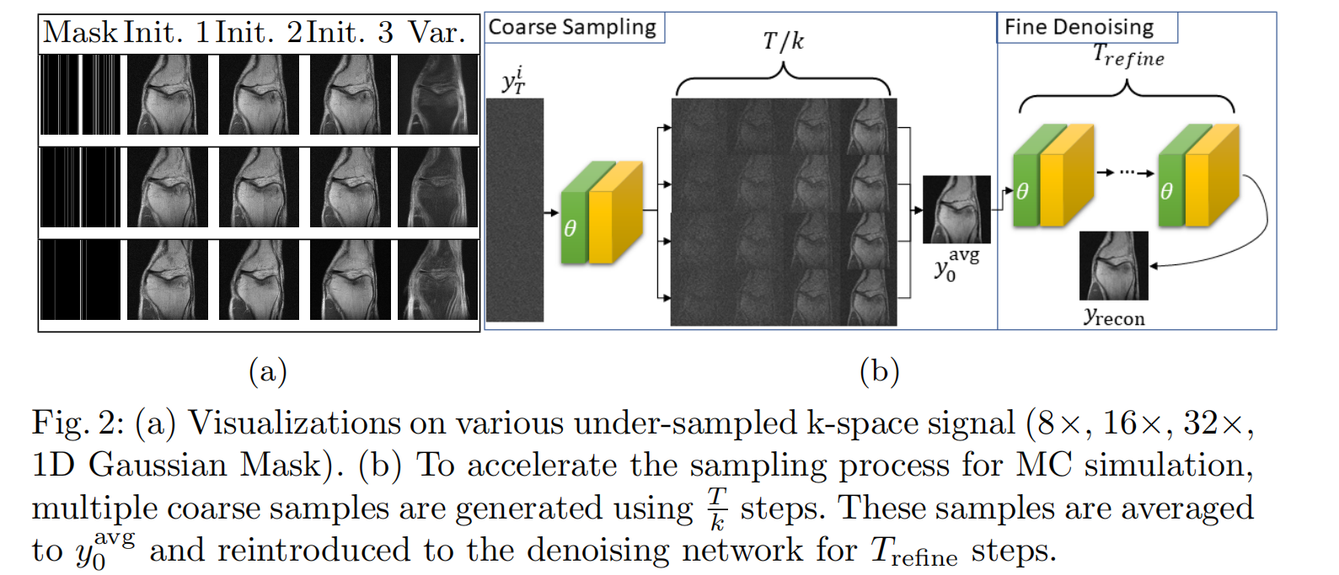
Towards performant and reliable under-sampled MR reconstruction via diffusion model sampling
Accelerate Sampling: From coarse to fine
重采样分为上采样和下采样，区分的依据是重新采样时新采样率与原先采样率的大小的比较。上采样和下采样都是针对信号最高频率而言。
上采样：采样频率高于信号最高频率的２倍，又称为插值/内插；
下采样：采样频率低于信号最高频率的２倍，又称为抽取。
重采样的方法：主要是最近邻法、双线性内插法以及三次卷积内插法。
欠采样与过采样主要是针对不平衡数据集。
欠采样：当数据集不平衡时，选择减少数据量过多类别的数量，例如对于一个只用0和1的二分类问题，样本标签1有10000个数据，样本标签0有6000个数据时，为了保持样本数目的平衡，可以选择减少标签1的数据量。过采样：就是对数量较少的类别，扩大它的数量，通过数据增强的方法增加它的数目。

Slide 6
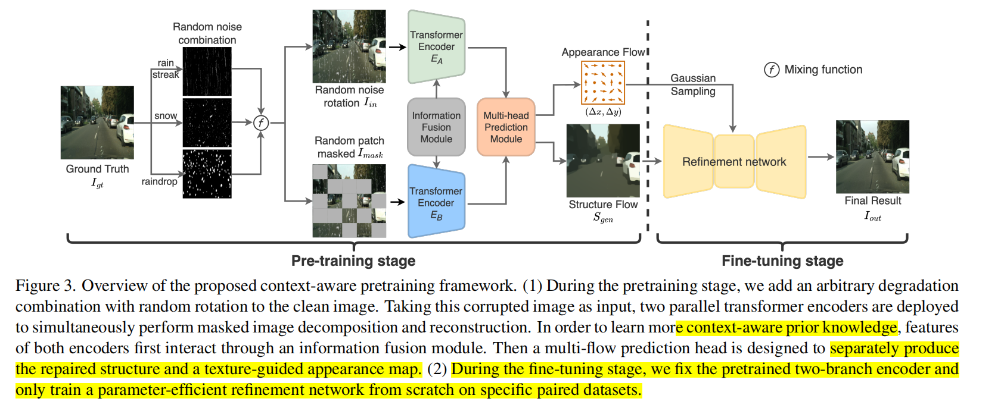
Context-aware Pretraining for Efficient Blind Image Decomposition
Self-supervised
Structure 与Mask的关系
为了解决上述问题，我们结合 Masked AutoEncoder (MAE) 提出了一种高效且简单的预训练模式：Context-aware Pretraining (CP)，包含两个 pretext 任务：混合图像分离和损失图形重建。设图像的恢复过程遵循从结构到纹理的模式 (coarse-to-fine)，我们的思路很简单，首先利用两个 pretext 任务在预训练阶段重建出结构信息，随后在 fine-tuning 阶段即可快速地基于结构进行纹理填充。
All-in-one VS CP

Slide 7
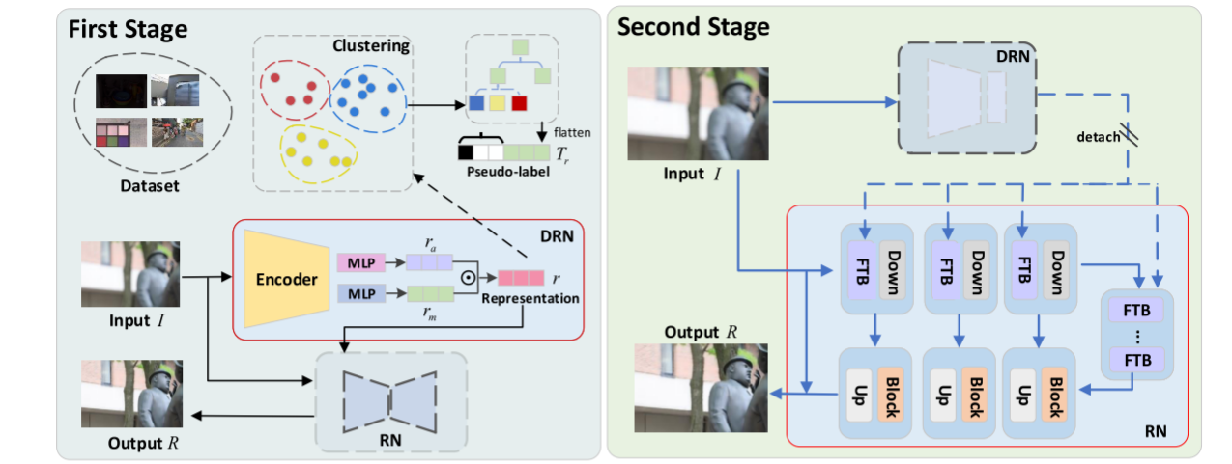
All-in-one Multi-degradation Image Restoration Network via Hierarchical Degradation Representation
Image restoration is a critical topic in low-level vision, which generates a high-quality image from a damaged image caused by degradation, e.g. , blurriness, noise, and low illumination.
The multi-degradation that this paper focuses on refers to a dataset with multiple degradations, differing from mixed degradations in an image.
The first stage is designed to construct the hierarchical representation of degraded images(?), and the second stage is to remove degradation artifacts to produce a high-quality image with the supervision of degradation representation by fixing the parameters of the DRN and retrain the RN.

Slide 8
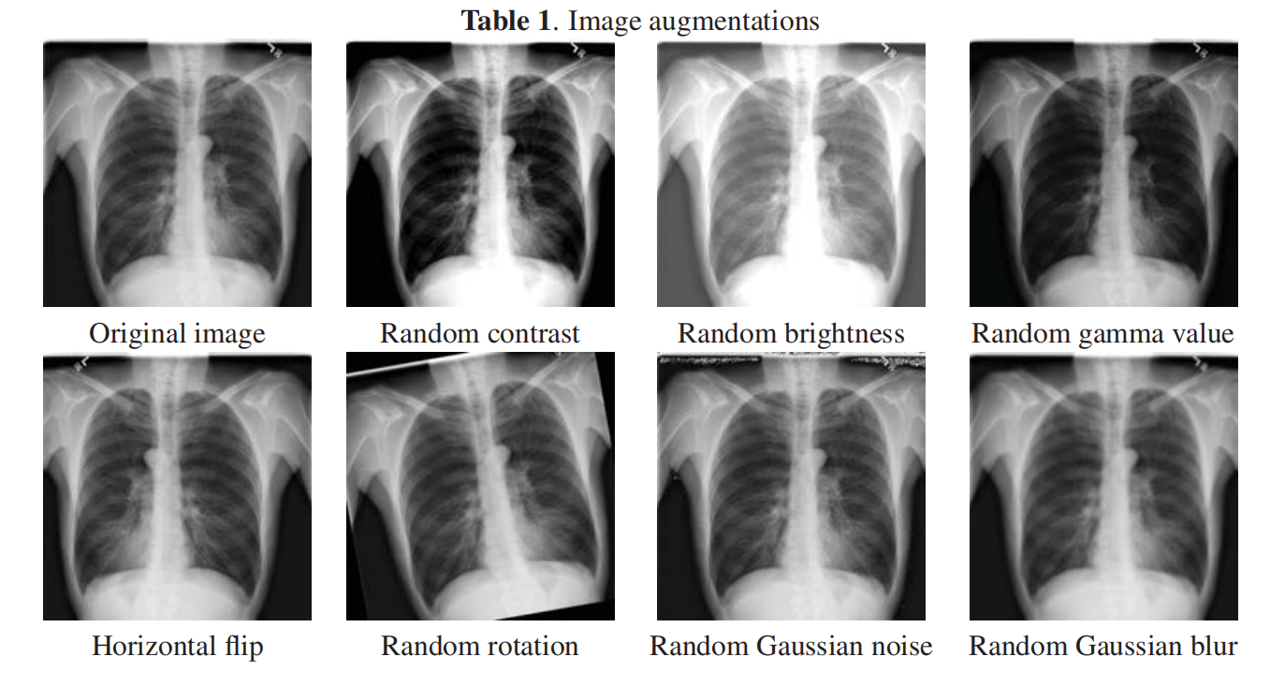
DATA AUGMENTATION FOR CHEST PATHOLOGIES CLASSIFICATION
In our work we used geometric, color and noise augmentations, which can be classified into such categories: 1) Affine transformations: horizontal/vertical flip, random degree rotations. 2) Color transformations: random brightness, contrast, gamma transformation. 3) Image quality transformations: additive Gaussian noise, random blur.
Keeping the natural bias of images is a necessary condition of data augmentation transformations, e.g. a transformation which somehow hides a lung nodule will negatively affect a classification model.

Slide 9
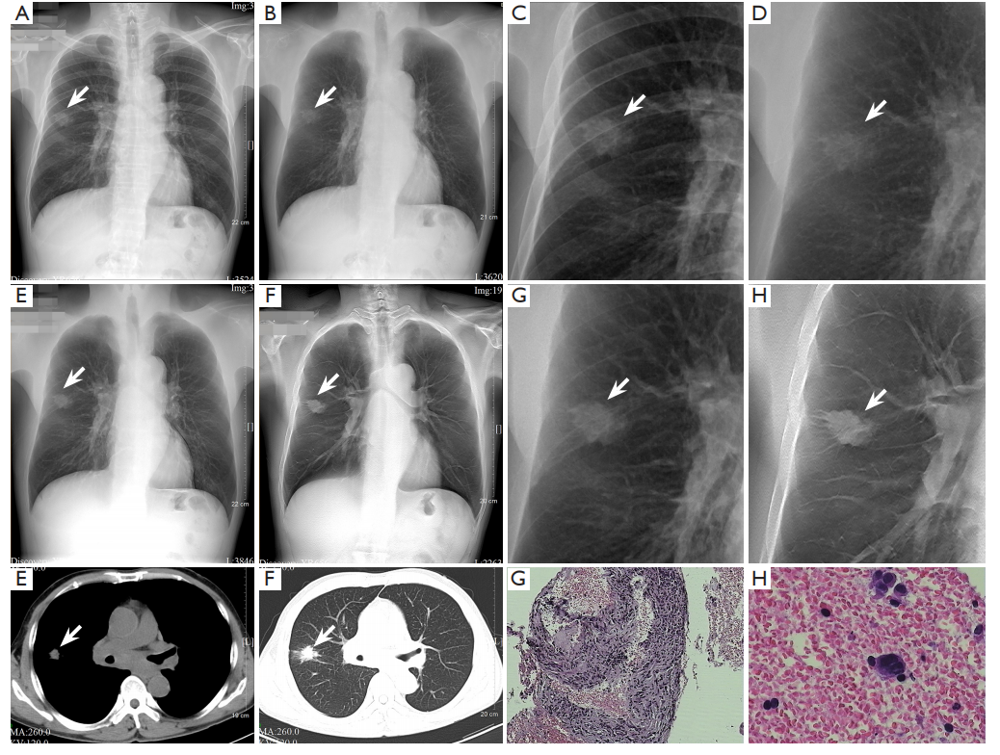
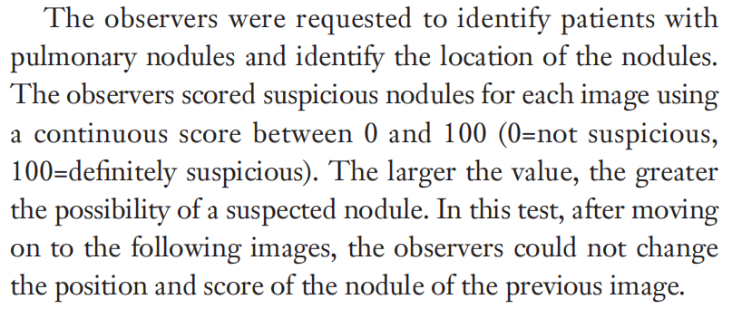
Improved detection of solitary pulmonary nodules on radiographs compared with deep bone suppression imaging
(A,C) Conventional chest radiography images show cancer partly obscured by ribs.
(B,D) Deep bone suppression imaging of soft tissues clearly show the cancer location, with different lengths of burrs.
(E,G) Dual-energy subtraction soft-tissue images also clearly show cancer.
(F,H) Lesion features are apparent on digital tomosynthesis(DTS) images, and even include pleural traction signs.
(I,J) Computed tomography(CT) images show the nodule more details, with shallow lobulation, different lengths burrs, and pleural stretch.
Subjective Evaluation:
Six observers, comprising 3 radiologists (10–30 years' experience each) and 3 radiology residents (2–3 years' experience each), evaluated the 256 study cases in different randomized orders.
In each reading session, the observers first analyzed the
CCR images, then CCR plus deep BSI images, then CCR
plus DES images, and finally, the DTS images, with the
reading time limited to 3 min.

Slide 10
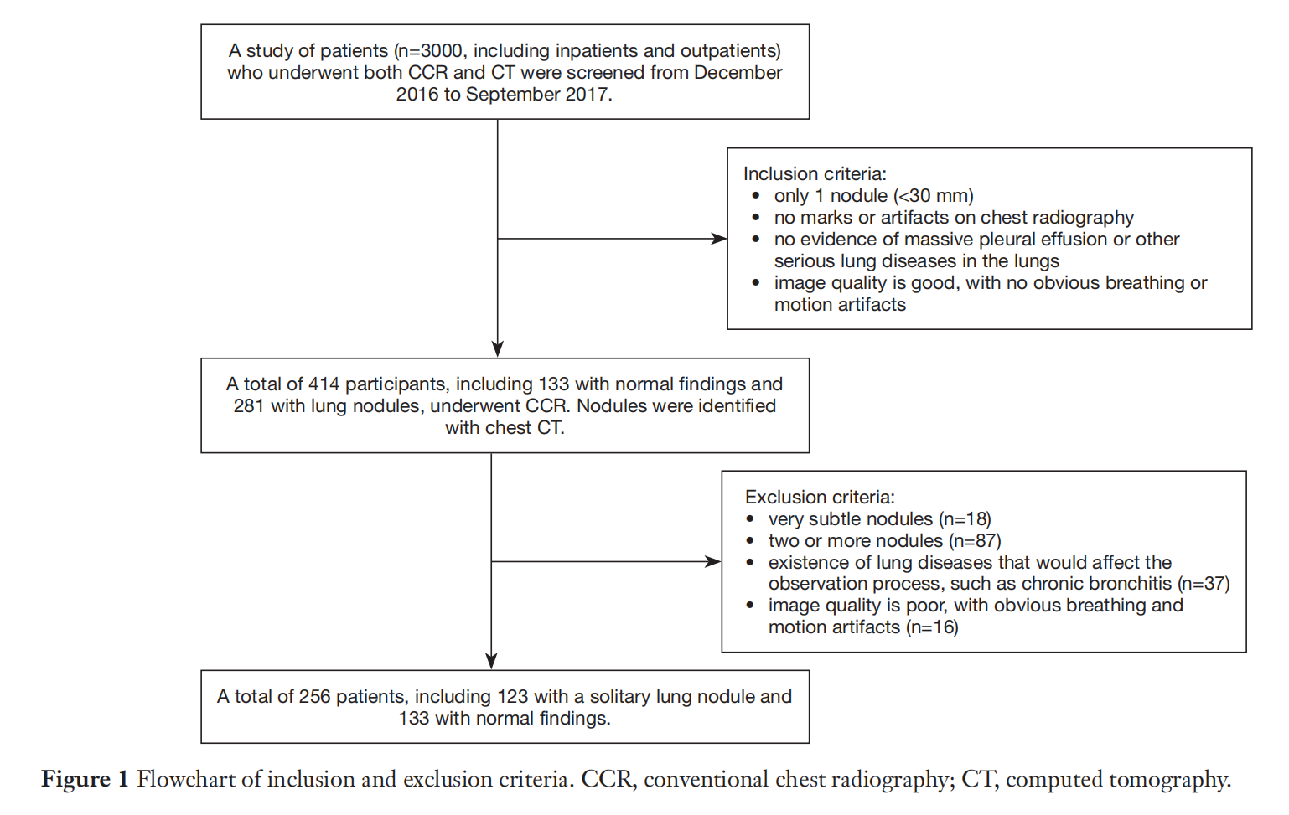
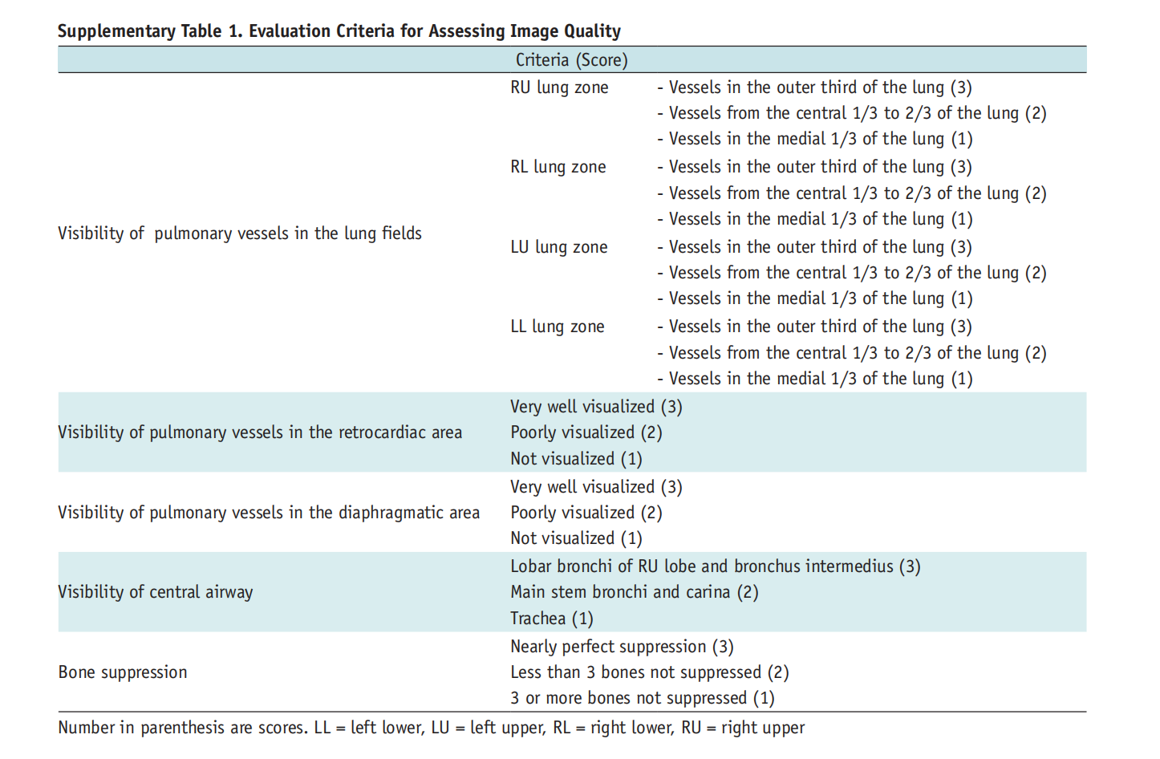
Bone Suppression on Chest Radiographs for Pulmonary Nodule Detection: Comparison between a Generative Adversarial Network and Dual-Energy Subtraction
关注数据获取方式的描述
用设备和DL合成的骨抑制图像对比的主观评价指标
1. IoU (Intersection over Union)，交集并集比
2. ROI (region of interest) , 感兴趣区域
3. ROC (Receiver Operating Characteristic curve) 受试者工作特征曲线
4. AUC (Area Under the Curve) ， 曲线下区域
首先要区分，前两个是目标检测领域的术语；后两个是从医疗领域引进的，但是所有机器学习准确率都可能用到该指标。
区分：ROC/AUC
IoU/ROI

Slide 11
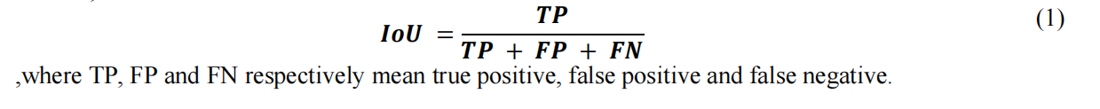
Value of bone suppression software in chest radiographs for improving image quality and reducing radiation dose
Bone suppression software significantly improved the image quality of bone suppression images with a relatively lower radiation dose, compared with dual-energy subtraction technique.
后续可以关注这篇论文，可以借鉴。
Computer-aided Detection of Lung Tumors in Chest X-ray Images Using a Bone Suppression Algorithm and A Deep Learning Framework
Segmentation: U-Net
Classification: VGG, the outline of the model is the second half of the segmentation model.
For this classification, we used an RGB image as input, where the labels obtained by segmentation are combined with the original chest X-ray image. Since the classification is performed using the output image of segmentation as input, the
segmentation result must be excellent.
The Curve (AUC) as evaluation method for classification. IoU is an index often used to evaluate object detection and segmentation tasks and it represents how large the predicted label is overlapped with its ground truth label.
在实验中，我们发现IoU的值随着输入图像大小的增大而下降，这是因为图像越大，各像素点之间的空间关系更加复杂，做精确的分割也更加困难。

Slide 12
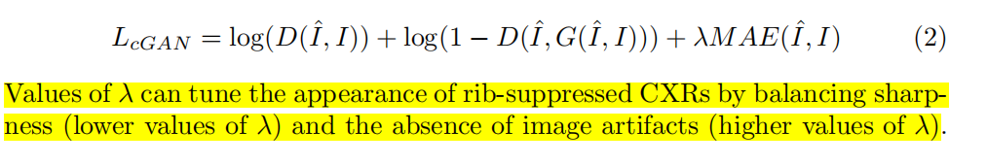

Evaluation of Deep Learning Methods for Bone Suppression from Dual Energy Chest Radiography
Our results show that wavelet decomposition does not improve the rib suppression, “skip connections” modification outperforms baseline autoencoder approach with and without the usage of the wavelet decomposition, the residual models are trained faster than plain models and achieve higher validation scores.
The double-shot DES images are usually partially misaligned due to motion artifacts, e.g. patient breathing. To compensate for such misalignment, low energy diagnostic CXR were first non-rigidly registered to DES soft-tissue images.
The “skip connections” idea improves the standard autoencoder in a number of ways: it addresses the “vanishing gradient” problem and helps to preserve small details of the original image.
During the initial experiments, it was noticed that the higher contribution of MS-SSIM led to better results yet slower convergence. To account for this observation and train network efficiently, the weight of MSSSIM was gradually increased at every training epoch.
关注$λ$
使用L1正则而非L2正则的原因在于，L1正则比L2正则导致的图像模糊要少一些，但L1的缺点在于不能捕捉sharp edges和fine textures，它帮助学习general appearance of skeleton.
同时关注论文中对于数据增强的处理方式，可以借鉴。
PatchGAN可用于图像的模糊重建

Slide 13
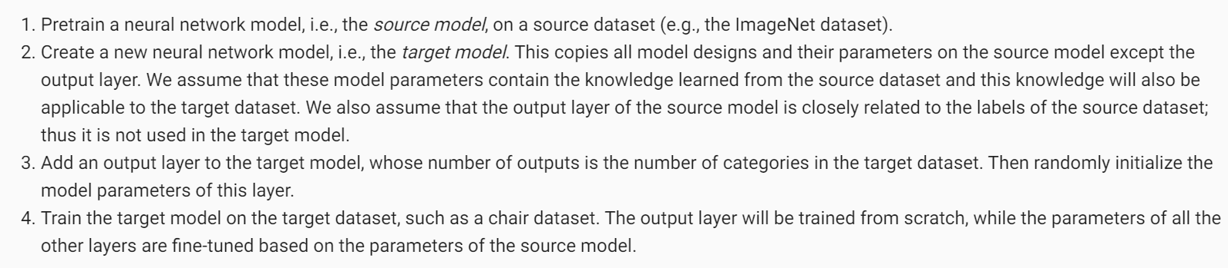
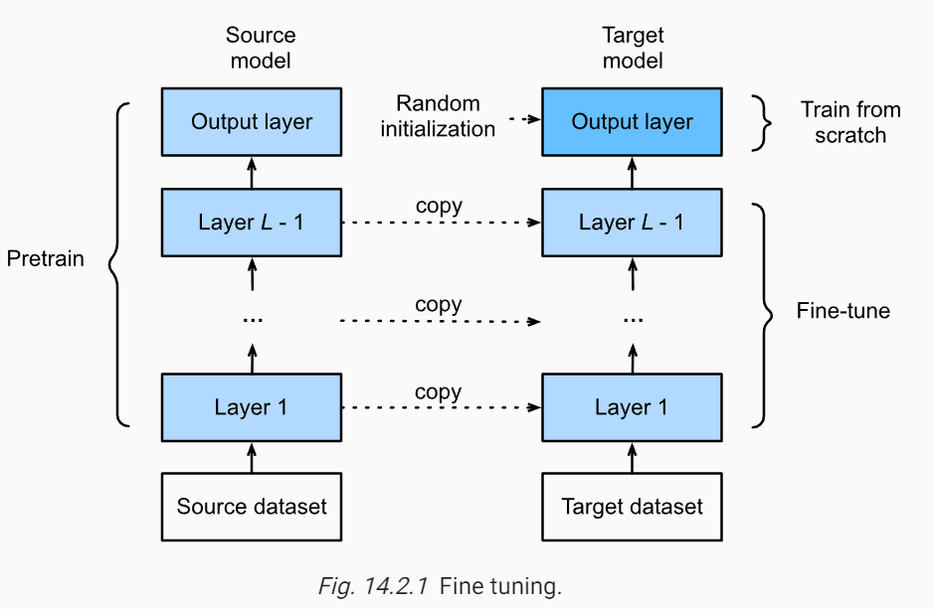
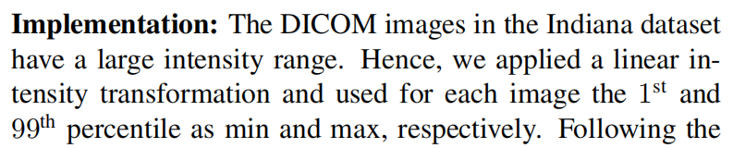
WHEN DOES BONE SUPPRESSION AND LUNG FIELD SEGMENTATION IMPROVE CHEST X-RAY DISEASE CLASSIFICATION?
In many applications combining different predictors can lead to improved classification results, which is known as ensemble forming.
DICOM的线性映射？
使用1st和99th percentile作为最小和最大值可以确保保留了大部分图像的信息，同时去除了一些异常值和噪声，使得图像更适合可视化和分析。

Slide 14
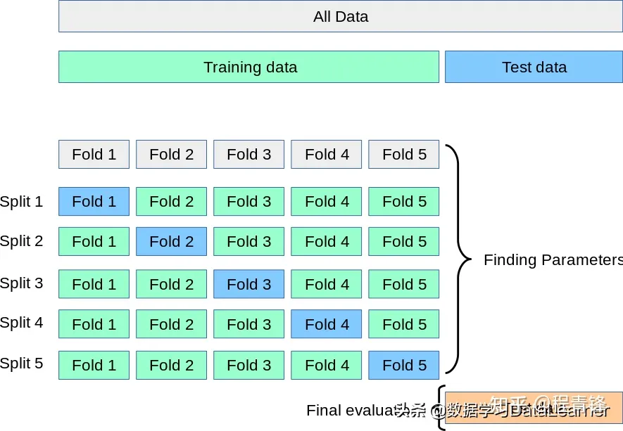
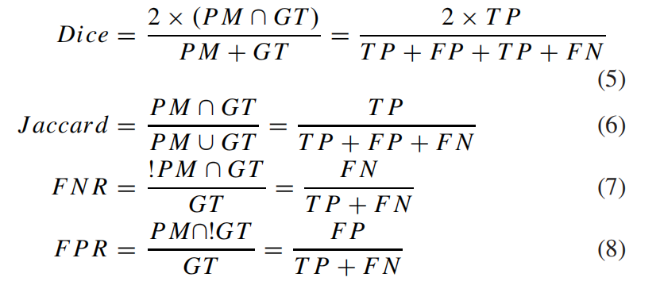
Image-to-Images Translation for Multi-Task Organ Segmentation and Bone Suppression in Chest X-Ray Radiography
A multitask deep learning model that generates simultaneously the bone-suppressed image and the organ-segmented image, enhancing the accuracy of tasks, minimizing the number of parameters needed by the model and optimizing the processing time, efficiency in learning optimizes the number of required parameters, memory or storage requirements, computational time and training convergence rate. all by exploiting the interplay between the network parameters to benefit the performance of both tasks.
多器官分割用的模型：Pix2PixMTdG(d表示扩展卷积)
The Jaccard index is a metric that measures the percent overlap between the target ground-truth mask (GT) and our prediction mask (PM)==IoU
交叉验证的目的：
从有限的学习数据中获取尽可能多的有效信息；交叉验证从多个方向开始学习样本的，可以有效地避免陷入局部最小值；可以在一定程度上避免过拟合问题；提升模型的泛化能力。
Notes:
N折交叉验证有两个用途：模型评估、模型选择。
N折交叉只是一种划分数据集的策略。想知道它的优势，可以拿它和传统划分数据集的方式进行比较。它可以避免固定划分数据集的局限性、特殊性，这个优势在小规模数据集上更明显。
把这种策略用于划分训练集和测试集，就可以进行模型评估；把这种策略用于划分训练集和验证集，就可以进行模型选择。
不用N折交叉验证就不能进行模型评估和模型选择了吗？当然不是。只要有测试集，就能进行模型评估；只要有验证集，就能进行模型选择。所以N折交叉验证只是在做这两件事时的一种可选的优化手段。

Slide 15
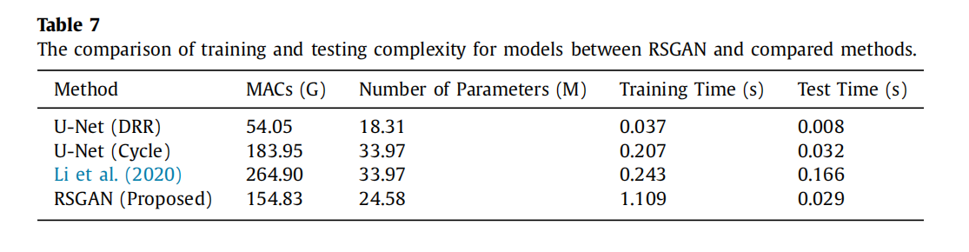
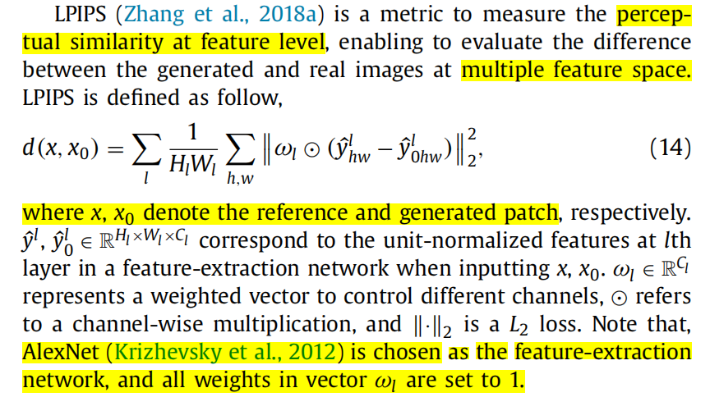
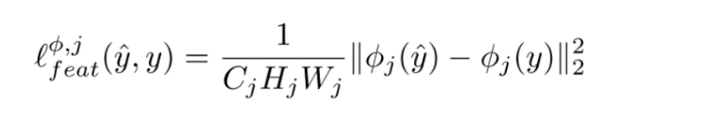
GAN-based disentanglement learning for chest X-ray rib suppression
关注模型的应用评估：
We employ two downstream applications, including lung disease classification and tuberculosis detection, to evaluate the quality of the imputed rib-suppressed CXR images.
Model Complexity
MACs (Multiply Accumulate Operations)
Feature construction loss
Johnson, Justin, Alexandre Alahi, and Li Fei-Fei. "Perceptual losses for real-time style transfer and super-resolution."
Zhang, Richard, et al. "The unreasonable effectiveness of deep features as a perceptual metric."

Slide 16
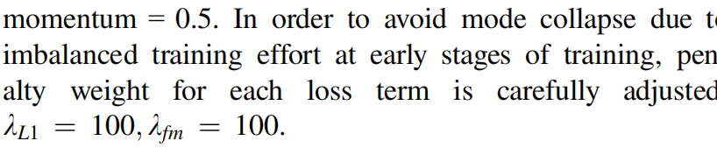
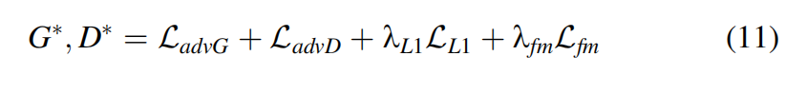
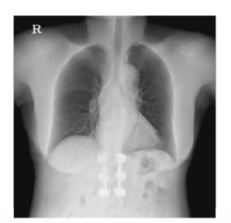
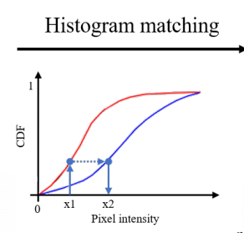
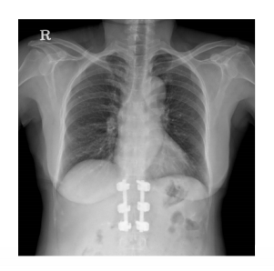
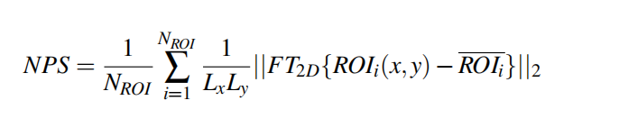
Dilated conditional GAN for bone suppression in chest radiographs with enforced semantic features
关注penalty weight的选择
In JSRT dataset, each image is of 2048*2048 resolution with three channels in PNG format. Considering the time and memory cost, we rescaled these images to 256*256 resolution, and the range of their pixel values has been linearly scaled to 0-255(more uniform).
Learning Bone Suppression from Dual Energy Chest X-rays using Adversarial Networks
Such a naive adoption of convolutional auto-encoder families(G.2017) often fails to capture the sharpness since the network misses high frequency details, which are the main reason of blurry images, in its encoding and decoding system. U-Net have overcome this limitation and achieved high performance on segmentation task with skip connection in the auto-encoding process.
Noise Power Spectrum (NPS) This metric gives a complete description of the noise with its amplitude over frequency
resolution.

Slide 17
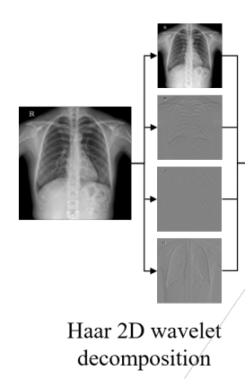
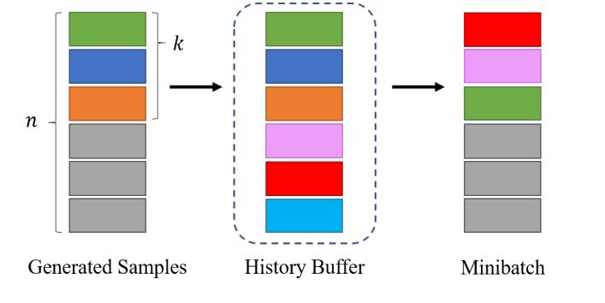
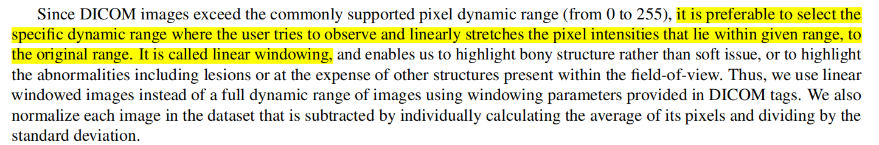
Learning Bone Suppression from Dual Energy Chest X-rays using Adversarial Networks
However, it still suffered from the lack of training data, which leads the model to often fail to capture the outline of the small blood vessels in the lungs and chest.
关注一下History Buffer优化
Haar 2D Wavelet Decomposition + GAN有效
Frequency information obtained from wavelet decomposition have a very critical role in training deep neural network. e.g., Pix2Pix
先做linear transformation
再做linear mapping
这一过程叫linear windowing
The artifacts processing: We manually examined the dataset since there was no post processing to handle this problem in acquisition of original images. 11 X-ray images were excluded from the training set and used for additional test. In this case, the ground truth obtained via DES can not be used as a reference image to evaluate the results. So in a qualitative manner, the motion artifacts due to heart beat did not appear and almost all information was maintained without blurry results.

Slide 18
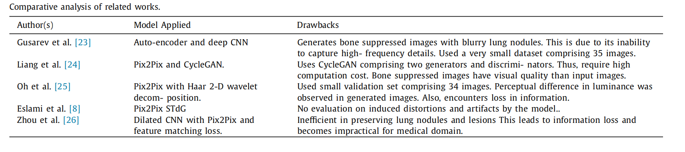
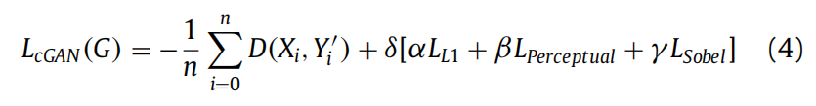
Spatial feature and resolution maximization GAN for bone suppression in chest radiographs
It is equally important to preserve spatial information and image quality because they provide crucial insights on the size and area of infection, color accuracy, structural quality, etc.
Minimize the visibility of bones in CXRs while ensuring maximum retention of critical information
‘CheXNeXt’ for the screening of 14 categories of diseases such as pneumonia, fibrosis, emphysema, and effusion, etc. have developed a model ‘Covid-Screen-Net’ for mass screening of COVID-19.
普遍的模型存在以下缺陷：hard denoising, that leads to a reduction in the sharpness of an image, loss of texture, and introduction of small artifacts.
We pre-set the value of α as 1 and find the relative values of β and γ. 下一页PPT有详细解释参数选择实验
a resolution of 512 × 512 is sufficient for the detection of lung diseases and nodules. Therefore, we resized all the images to 512 × 512 × 3 for training SFRM-GAN
Notes:
‘CheXNeXt’: https://journals.plos.org/plosmedicine/article?id=10.1371/journal.pmed.1002686
Covid-Screen-Net: https://pubmed.ncbi.nlm.nih.gov/33821094/

Slide 19
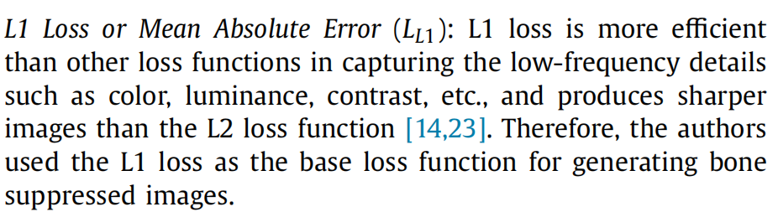
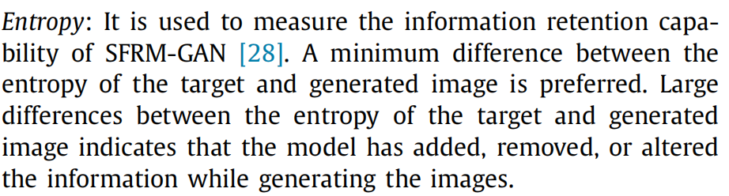
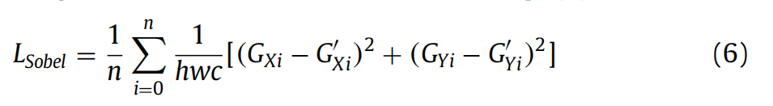
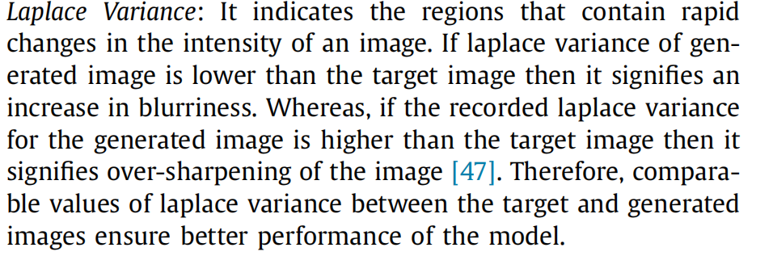
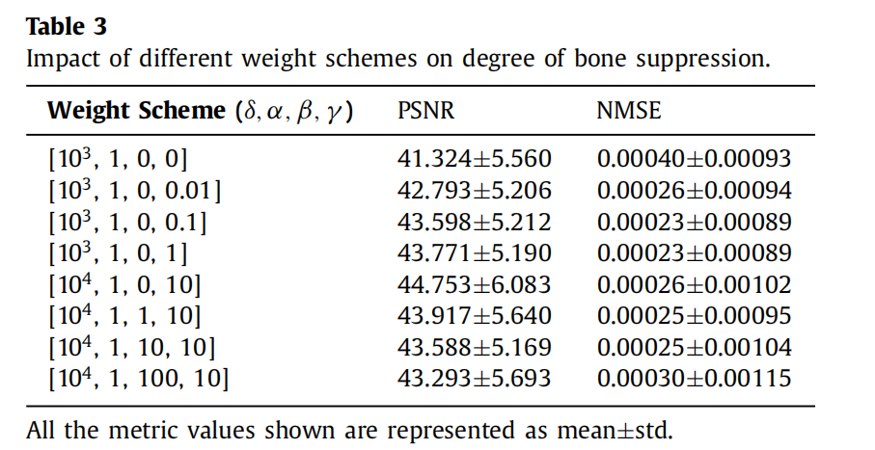
Sobel Loss using Sobel operator
Role: Detect edges and determine the gradient error. The model becomes more susceptible to the changes in high-frequency details, i.e., lung boundaries, blood vessels, infectious areas, etc.
不同评价指标作用：
They used the combination of PSNR and NMSE to indicate the degree of bone suppression. Next, they calculate SSIM and Laplace Variance to indicate retention of spatial feature resolution. Further, the authors measure Entropy and BRISQUE(不用) score to indicate the preservation of spatial feature information.
关注一下论文中损失函数权值的确定方式，具体见论文
Notes:
左边是损失函数，右边是评价指标，重点关注它们各自的作用与特点。

Slide 20
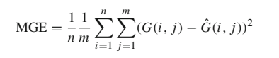
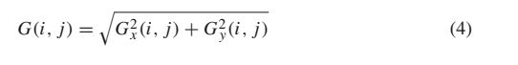
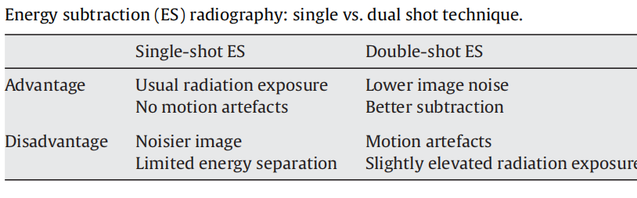
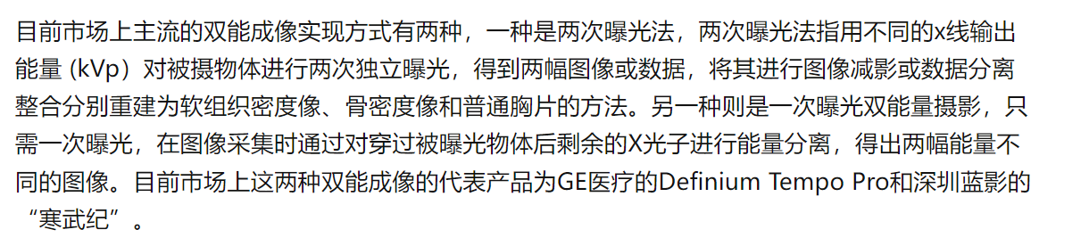
Single image super-resolution based on a modified U-net with mixed gradient loss
Mixed gradient error
https://link.springer.com/article/10.1007/s11760-021-02063-5
在上页论文中效果不好，改成了Sobel loss
The aim of measure the gradient error is to learn a sharp edge which is close to the ground truth edge.
Dual energy subtraction: Principles and clinical applications
共同点：一次三张图片
双能成像实现方式---均可获得高低两种能量

Slide 21
Bone Suppression on Chest Radiographs With Adversarial Learning
Image2Image
While training with paired images yields slightly better performance than that of unpaired images when measuring with two objective image quality metrics, namely Structural Similarity Index (SSIM) and Peak Signal-to-Noise Ratio (PSNR), training with unpaired images(Unsupervised Learning) demonstrates better generalization ability on unseen anteroposterior (AP) radiographs than paired training.
Unpaired?----Unpaired training radiographs consist of a source set and a target set, with no information provided as to which standard CXR matches which bone suppressed CXR.(任意的两对)
We find that the GAN models introduce minimal motion artifacts compared with the dual-energy subtraction technique. The reason is that there is only a small portion of training data in the DE dataset contains motion artifacts. The image-to-image translation models tend to learn the majority of information from the entire data distribution. This characteristic of adversarial learning models can be considered as yet another main advantage of automatic bone suppression in addition to less radiation exposure.
Generating Dual-Energy Subtraction Soft-Tissue Images from Chest Radiographs via Bone Edge-Guided GAN
Detection of Bone-Edge
Considering that only a limited number of subjects are used for detecting bone edges, we employ the same architecture as the most compact FC-DenseNet56 model.(防止过拟合)
模型能力：In the test stage, our method only required about 1.04 seconds (0.83 s for edge detection and 0.21 s for image synthesis) to generate the bone edge map and DES-like soft-tissue image for an unseen CXR image.

Slide 22
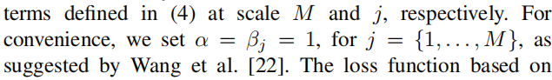
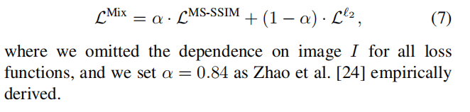
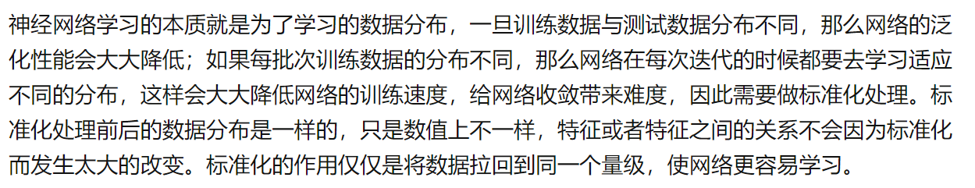
Deep Learning Models for Bone Suppression in Chest Radiographs
Supervised:
Regressors are trained or optimized by teaching DES radiographs to estimate the soft-tissue or bone images.
Unsupervised:
Do not require teaching DES with radiographs, but these methods need segmentation and the border locations of bony structures. The bone-free images are reconstructed with the blind-source separation approach, or the gradient images modified according to the intermediate results.
MS-SSIM/SSIM loss pays attention primarily to local neighborhood changes.
CLAHE的作用: CLAHE for local contrast enhancement, so local details can therefore be enhanced even in regions that are darker or lighter than most of the image.
测试和训练数据一起做预处理操作的目的：

Slide 23



Bone suppression for chest X‑ray image using a convolutional neural filter
双能减影图像的另一缺点：
Organs with attenuation coefficients similar to bone are depicted on bone-extracted images along with bones themselves. If training is conducted based on such images, the output image will depict organ information as well as bone like the teacher image. Some organ information is thus lost in processing of the bone-suppressed image.
Bone-extracted images, which is the difference image between input image and ideal image, were used as teacher images.
The results of comparison between the proposed
method and the results described in those five papers.
Not the same dataset!

Slide 24



Bone suppression for chest X‑ray image using a convolutional neural filter
基于Patch的思想
The architecture of the CNF
Input to the CNF is 31 × 31 pixel values neighboring the target pixel. Output from the CNF is a value of the bone component of the target pixel.
Applying a Conditional GAN for Bone Suppression in Chest Radiography Images
Comparison:
Similar/Same 的dataset/technique

Slide 25


Autoencoder-based bone removal algorithm from x-ray images of the lung
Gusarev, M数据集描述
Deblurring Method:
1.Createa cascade solution, where a new neural network is included to remove blur from the output images.
2.It is also possible to use traditional image processing techniques to improve the quality of the output image. Simple example of such techniques are filters, like Bilateral, Wiener or Laplacian filter.
参考本篇论文中Different learning rate schedules
Acknowledgements: We would like to thank the researchers from the Innopolis University, Innopolis, Russia for sharing The Bone Suppression dataset.
Bone suppression on pediatric chest radiographs via a deep learning-based cascade model
Domain adaptation:是迁移学习的一种，主要解决数据不方便采集，数据标注耗时费力等情况。
不同输入数据集也可以做消融实验。
Visual scoring regarding bone suppression metrics
Score 5 implies that bones were almost fully invisible throughout; score 4 implies that bone suppression was good, although the remaining bone density was lower than the pulmonary right hilar vascular density; score 3 implies that bone suppression was good, although the remaining bone density remains at the level of pulmonary right hilar vascular density; score 2 indicates that bone suppression was partially incomplete; and score 1 indicates that bone suppression was not achieved.

Slide 26




DEEP FEATURE DISENTANGLEMENT LEARNING FOR BONE SUPPRESSION IN CHEST RADIOGRAPHS
An accurate bone suppression algorithm requires the model to identify the location of bony structures and discard them but retain the information about soft-tissue overlapping with the bones.
Guide借鉴:
Our goal is to retrieve the soft-tissue image S from the chest radiograph. Most of existing methods force the networks to map X to S without any supplementary guidance except for the reconstruction supervision. The lack of precise supervision signal makes learning inefficient and leads to suboptimal results. To address this issue, we propose a multi-task learning strategy to clearly guide the network to focus on the most important regions and separate the two components.
MSE缺点:
However, the MSE loss ignores the correlation between pixels and may lead to undesirable blurring of output images.
借鉴: Visualization of zoomed in images to display details.
MS-SSIM参数选择：
Cross-Entropy
原论文中，$α_{5}=0.1333=β_{5}=γ_{5}$，这里$α=1$是为了方便起见。

Slide 27



Deep learning-based bone suppression in chest radiographs using CT-derived features: a feasibility study
激活函数PReLU
当a=0时，PReLU就变成了ReLU，而且 a 是一个可以学习的参数。如果 a 是一个小的固定值， PReLU就变成了 LReLU （Leaky ReLU)。LReLU目的是为了避免零梯度，实验表明LReLU相较 ReLU对准确率几乎没有提高，但是PReLU的参数 a 可以自适应学习，从而可以获得专门的激活函数
流程
From 3D to 2D: Transferring knowledge for rib segmentation in chest X-rays
GAN的其中一个作用：Domain adaptation or Transfer the knowledge
High-Resolution Chest X-Ray Bone Suppression Using Unpaired CT Structural Priors
含internal validation
Histogram matching is a method that can preserve the detail of the original image and match the intensity distribution of the target image.
Subjective Evaluation除了看骨抑制效果外，还可以判断图片中有无abnormal，即做诊断。
Bone Suppressed CXR for Automatic Disease Classification using DensNet-121:
?We concatenate two original CXR images and one bone-suppressed CXR image of our method to form three channels. We also take only the bone-suppressed CXR images of the Shenzhen hospital dataset as input to test the performance.

Slide 28




Bone suppression of lateral chest x-rays with imperfect and limited dual-energy subtraction images
Multi-scale and dual-domain
In fact, the gradients contain enough information for reconstructing the images. Moreover, the gradients are sparse, and the probability of both soft-tissue and bone components having large gradients of the same orientation at the same location is low (Chen et al., 2009). Therefore, the soft-tissue and bone components of CXRs in the gradient domain are more separable than in the intensity domain.
后续关注MAP
蒸馏学习（Distillation Learning）

Slide 29


Improving Tuberculosis Recognition on Bone-Suppressed Chest X-rays Guided by Task-Specific Features
Existing bone suppression models are usually trained on a relatively small dual-energy subtraction (DES) dataset with fewer variety of CXRs, thus ignoring the specificity of tuberculosis in CXRs from other datasets. Recent studies have shown that modeling the disease-associated image specificity helps improve disease detection performance.
DICOM格式图像的预处理方法
Shallow Network: ResNet18
Multi-scale CXR features, i.e., f1, f2, f3 and f4 can be explicitly transferred to the image synthesis network (via channel-wise addition) to guide the image synthesis process.
Four state-of-the-art methods that perform simultaneous TB diagnosis and TB area detection
In addition, the BCTR also achieves better results compared to BCTR-3 that finetunes the classification network in the second training process. This implies that using bone-suppressed CXRs to finetune a classification network pretrained on CXRs may not produce good results, which is different from previous findings that finetunning usually improves the classification performance. This may be due to the significant heterogeneity between CXRs and bone-suppressed CXRs.

Slide 30


DeBoNet: A deep bone suppression model ensemble to improve disease detection in chest radiographs
Ensure if the models learned to highlight regions containing COVID-19-consistent findings and not the surrounding context by using CRM Algorithms
Application: Classify and (to localize) pulmonary lesions
F-EB0-BS bone suppression model is truncated and added with the classification layers
quantitative and qualitative
应用评估使用的数据集
COVID-19 CXR collection
RSNA CXR dataset
任务：分类Normal or COVID-19
For classification, we initially used a custom U-Net model[1] proposed in to segment the lung ROI on the CXRs. This approach ensures that the models learn relevant features from the lung ROI and not the surrounding context.
AUROC, confusion matrix, Sankey diagram, and AUPRC curves
Notes:
Sankey diagram反映了数据在不同实体之间的流动情况 [1] Analyzing inter-reader variability affecting deep ensemble learning for COVID-19 detection in chest radiographs

Slide 31


Cascade of multi-scale convolutional neural networks for bone suppression of chest radiographs in gradient domain
The task of predicting bone or soft-tissue components from a CXR is analogous to image denoising, rain drop
removal, and edge-aware filtering.
Gradient domain[1]优点：
The gradients contain enough information for reconstructing the images. Moreover, the gradients are sparse, and the probability of both soft-tissue and bone components having large gradients of the same orientation at the same location is low. Therefore, the soft-tissue and bone components of CXRs in the gradient domain are more separable than in the intensity domain. The mapping between the gradients of CXRs and their bone components may be less complicated than the mapping between the intensities.
区分几个概念：
尺度：图像的模糊程度
尺度越大，分辨率下降，是downscale的结果，显示的是全局特征。
From coarser to finer
Notes:
[1]Gradient-domain image processing:
http://graphics.cs.cmu.edu/courses/15-463/2019_fall/lectures/lecture9.pdf

Slide 32



Bone Suppression of Chest Radiographs With Cascaded Convolutional Networks in Wavelet Domain
Compared with previous work of CamsNet model which preforms bone prediction in gradient domain, the Wavelet-CCN model predicts the wavelet coefficients to reconstruct bone images and can avoid the inconsistent background intensity caused by 2D integration of gradients.
The conclusion is remarkably consistent with Zhao et al. who reported that when the L2 or PSNR metrics were used to evaluate image quality, the network trained with the L1 loss function outperformed the one trained with the L2 loss function.
Wavelet decomposition results of (a) CXR image, (b) DES bone image, and (c) DES soft-tissue image. (d), (e), and (f) are the corresponding histograms of each sub-band images
in (a), (b), and (c), respectively.
The motion artifacts are almost eliminated visually.

Slide 33




Cascade of multi-scale convolutional neural networks for bone suppression of chest radiographs in gradient domain
Visualization of the learned filters of a CamsNet
Visualization of the feature maps for different convolution layers.
The majority of the filters were similar to edge detectors of different scales from different directions. These edge detectors were used to reconstruct the gradients of the bone image, and they were considered to be the base for reconstruction.
In these maps, the details related to soft-tissue structures were canceled out. The output bone gradients were sharper than the input bone gradients。
We set 0.1 and 99.9 percentiles in the ground truth image Z as the values of $Zmax$ and $Zmin$, respectively, to reduce the effect of outliers on the quantitative metrics.

Slide 34
Generating Dual-Energy Subtraction Soft-Tissue Images from Chest Radiographs via Bone Edge-Guided GAN
骨抑制存在的两大挑战：
However, eliminating artifact effects completely is difficult due to the challenge of accurately locating the motion artifact areas. Due to imperfect ground truth, some residual bone edge signals remaining in DES images, supervised deep models trained on DES data cannot suppress bone components of CXRs thoroughly.
Evaluation of Cross-Dataset Generalization
We further applied the proposed EGAN model to synthesize soft-tissue images from CXRs acquired by using different types of X-ray machines in our DES test set, the publicly available JSRT, NIH ChestXray 14(200 images), MC, and SH datasets.
Note that EGAN is trained on our DES dataset and directly applied to these five independent datasets.
Evaluation of Synthetic Images in Tuberculosis Diagnosis
1.A 5-fold cross-validation strategy is used.
2.Pre-processing:
Each CXR image was resized into a 256 × 256, followed by being cropped into 224 × 224(ResNet18的输入严格规定为3*224*224) and duplicated into three channels.
3.Even though a previous study have shown good results using pre-trained models on the NIH ChestXray14 or ImageNet dataset, we train the diagnosis models from scratch for the sake of fair comparison.
For bone suppression, the selection of prior knowledge is essential in prior-guided models.(i.e. prior = bone)
Notes:
crop无法保证在不失真的情况下将图片传入到CNN当中。常见的crop有两种：1-crop和10-crop。假设原图片大小为256 * 256，而规定的图片大小为224 * 224。1-crop：在256256这张图片的中心位置crop出一个224224大小的区域；10-crop：分别在左上角、右上角、左下角、右下角和中间分别crop出224 * 224的区域（5个了），再把图片镜像翻转，用同样的方式再crop, 即可得到10个。

Slide 35


Separation of bones from soft tissue in chest radiographs: Anatomy-specific orientation-frequency-specific deep neural network convolution
Single-shot DE imaging VS dual-shot DE imaging
Less motion artifacts in soft-tissue and bone images. Limitations of single-shot DE imaging are, in general, a slightly increased noise level and slightly poor energy separation. Because virtual DE imaging based on deep learning requires pairs of input chest radiographs and corresponding “teaching” DE bone and/or soft-tissue images with no/little motion, single-shot DE imaging is suited for creating images for training deep learning models.
Two-fold cross-validation
描述我们模型优秀的一些写作参考：
As seen, our scheme was better able to suppress bones including the ribs near the lung wall and the clavicles, and specifically rib edges, than the reference technique. Additionally, our new scheme was better able to maintain the conspicuity of soft-tissue structures such as lung nodules of various sizes and vessels under the clavicles and with overlapping ribs. This was achieved through our model的哪些功能…
Notes:
N折交叉验证有两个用途：模型评估、模型选择。
N折交叉只是一种划分数据集的策略。想知道它的优势，可以拿它和传统划分数据集的方式进行比较。它可以避免固定划分数据集的局限性、特殊性，这个优势在小规模数据集上更明显。
把这种策略用于划分训练集和测试集，就可以进行模型评估；把这种策略用于划分训练集和验证集，就可以进行模型选择。
不用N折交叉验证就不能进行模型评估和模型选择了吗？当然不是。只要有测试集，就能进行模型评估；只要有验证集，就能进行模型选择。所以N折交叉验证只是在做这两件事时的一种可选的优化手段。

Slide 36


Isometric Convolutional Neural Networks for Bone Suppression of Multi-Planar Dual Energy Chest Radiograph
Illustration of the X-ray scanner used to create dataset
Vascular visibility, contrast or sharpness也是软组织生成效果好坏的指标
Image Post Processing
作者分析了图像模糊和低对比度的原因； 作者提出了解决图像模糊和低对比度的方法。
具体详见以下网址
https://ieeexplore.ieee.org/document/9894637
The reason for the images to have lower contrast while having high evaluation is that the contrast of an image is calculated based on the lowest and highest pixel in the image. A model could miss predicted only single pixel and that pixel will drastically affect contrast of the whole image. Concretely, the outlier prediction. Outlier prediction in this case is the overly high or low predicted value. Even if there is only one pixel of outlier, every pixel value in the image will be re-scaled such that the outlier pixel is the brightest or darkest pixel resulting in a reduction of the contrast.
One cause of the quality deficiency is the resolution of the target image. Since there are more target values for the model to fit with a fairly small number of trainable parameters, model’s bias is expected and result in blurriness.

Slide 37

Development and validation of bone-suppressed deep learning classification of COVID-19 presentation in chest radiographs
Resize的方法：Nearest-neighbor interpolation
Model: The pre-trained 2 class ‘COVID-Net CXR2’ method and the ‘VGG16-Modified’ (Rajaraman S) method
VGG16 had been chosen because it had been used in previous chest disease classification studies and had demonstrated improved results over alternatives such as DenseNet-121 and ResNet-50.
JSRT数据集处理：
To train the bone suppression models, the dataset was cleaned by removing image pairs where poor suppression (defined as observing at least 1 rib or clavicle with edges visible across the lung tissue) and image artifacts were observed. A total of 217 image pairs (131 with nodule, 86 without nodule) remained after data cleaning.

Slide 38
Development and validation of bone-suppressed deep learning classification of COVID-19 presentation in chest radiographs
几个检测方法
敏感度就是有病的里边能看出来多少，特异度就是没病的里边能排除多少
阳性预测值就是某诊断实验说有病的人中有多少是真的有病的，阴性预测值(NPV)则反之
NPV is important because the public health consequences of missing a COVID-19 diagnosis was deemed to be greater than that of mistakenly identifying someone as infected.
使用N Cross-Validation
Future work: More image data could be acquired to improve both the classifier performance and the generality of the external test set. Other image enhancement techniques beyond bone suppression could be pursued to improve classification performance for other clinical conditions imaged using other modalities. Radiomics analysis of the enhanced images, and analysis of other non-deep learning features, could be combined with deep learning features to further improve classification performance.
The trained bone suppression models and VGG16-Modified models used in this study are available for use from https://github.com/danielnflam
.
COVID-Net CXR2 demands:
All images input into the classifier were processed as follows:
(I) the topmost 8% of the image was removed in order to remove metadata in the image; (II) the image was center cropped by removing both ends of the longer side of the image, such that the remaining image is square; (III) the image was resized using bilinear interpolation to 480×480 pixels; (IV) the image was input into the model’s neural network for classification.

Slide 39



Generation of Virtual Dual Energy Images from Standard Single-Shot Radiographs using Multi-scale and Conditional Adversarial Network
CXR: As a noninvasive, low radiation dose, and low cost imaging modality,
Dual energy subtraction (DES) can separate high-density material, such as bone, from soft tissue
PSNR is commonly used for evaluating quality of image compression/reconstruction, where our algorithm can be viewed as a compression/reconstruction process.
Image processing pipeline of bone suppression with cross projection tensor,这里的得到的软组织并不是直接相减
条件GAN

Slide 40



Generation of Virtual Dual Energy Images from Standard Single-Shot Radiographs using Multi-scale and Conditional Adversarial Network
Normalized all images to the range of [−1, 1] per image，Ground truth intensity maximum and minimum is then applied to the normalized virtual bone image to recover the final result.
介绍JSRT: the size of a pixel was 0.175 * 0.175 mm
主观应用评估：
Lung nodule detection+ FROC 具体实施方式如下
怎样表明骨抑制效果好：
Cardiac motion artifacts are significantly reduced in the virtual DE images. High-quality and high-resolution virtual bone and soft tissue images with subtle details(病变区域) are produced.
和谁比？Ground truth/其他方法
参考下一页

Slide 41


和其他方法比
和Ground Truth比

Slide 42



Chest X-ray Bone Suppression for Improving Classification of Tuberculosis-Consistent Findings
An ImageNet-VGG-16 model is pretrained on a large collection of publicly available CXRs.
A previous study shows the benefits of using CXR modality-specific models retraining toward improving classification and localization performance and model generalization.
新的评价指标：马修斯相关系数（Matthews correlation coefficient）
马修斯相关系数是在使用机器学习作为二进制（2类）的质量的度量的分类指标。
SSIM provides a superior indication of prediction performance as it exemplifies human visual perception. The MS–SSIM measure is an extension of SSIM that computes structural similarity at various scales and combines them. On the other hand, MAE preserves luminance and contrast in the predicted image.
新的评价指标：Comparing the histogram of the predicted image using the proposed bone suppression models and the ground truth in pixel value

Slide 43


Chest X-ray Bone Suppression for Improving Classification of Tuberculosis-Consistent Findings
For the finetuning task, fourfold cross-validation is performed in which the baseline and bone-suppressed CXRs in the Shenzhen and Montgomery TB collections are split at the patient level into four equal folds. The hyperparameters of the models are tuned while training on the three folds and validating with the fourth fold. The validation process is repeated with each fold, resulting in four different models.
We observed that the filters in the first convolutional layer learned the edges, contours, orientations, and their combinations, specific to the input image. However, in the deepest convolutional layer, the filter activations were abstracted to encode class-specific information. This demonstrated that deeper convolutional layers encode class-specific details, while the initial layers contain image-specific activations. Additionally, the activation sparsity increased with model depth.
Visualizing the activations of the first 64 filters in (a) block1-Conv1 layer and (b) block5-conv3 layer.

Slide 44
Palette: Image-to-Image Diffusion Models
Loss:
We find that while L2 and L1 losses in the denoising objective yield similar sample-quality scores, L2 leads to a higher degree of diversity in model samples, whereas L1 produces more conservative outputs.
Evaluation Metrics:
Specifically, we report Fréchet Inception Distance (FID), Inception Score, Perceptual Distance and Classification Accuracy for qualitative comparison. When computing FID scores, the choice of the reference distribution is important. In our work, we use the full validation set as the reference distribution. For Perceptual Distance, we use the Euclidean distance in the pool_3 feature space of the pre-trained InceptionV1network (same as the features used for calculating FID scores). We use EfficientNet-B0 top-1 accuracy for reporting ground truth Classification Accuracy scores.但分类用的是预训练好的ResNet-50!
所谓的Top-1 (Accuracy)是指排名第一的类别与实际结果相符的准确率，而Top-5 (Accuracy)是指排名前五的类别包含实际结果的准确率。
The ultimate evaluation of image-to-image translation models is human evaluation.
Self-Attention of U-Net in diffusion <Diffusion models beat gans on image synthesis>
We also find that removing self-attention layers from the U-Net architecture of Palette, to build a fully convolutional model, hurts performance. While self-attention layers provide a direct form of global dependency, they prevent generalization to unseen image resolutions. Generalization to new resolutions at test time is convenient for many image-to-image tasks, and therefore previous works have relied primarily on fully convolutional architectures.
个人理解：inpainting需要image resolution的generalization和a direct form of global dependency的平衡
Notes:
模型的泛化性能是模型适应新数据的能力，即模型在从未见过的数据面前，仍然保持一定适用性的能力。

Slide 45


CBCT-Based Synthetic CT Image Generation Using Conditional Denoising Diffusion Probabilistic Model
Our proposed conditional DDPM for sCT generation from CBCT, composed of unconditional forward(CT to CT) and conditional reverse processes.

Slide 46



CBCT-Based Synthetic CT Image Generation Using Conditional Denoising Diffusion Probabilistic Model
新的评价指标 normalized cross-correlation
PSNR measures if the predicted sCT intensity is evenly or sparsely distributed. NCC is a measure of similarity between CT and sCT as a function of displacement.
几种不同的条件diffusion
An unconditional DDPM is pretrained using CBCT images to translate the Gaussian noise to the CBCT image.即训练时不添加条件。
1.Iterative latent variable refinement (ILVR) take self-information (CBCT)
as condition 2.Weighted summation

Slide 47



CBCT-Based Synthetic CT Image Generation Using Conditional Denoising Diffusion Probabilistic Model
训练时添加条件
Adaptively noised condition instead of constant condition on each time step of noise estimation

